Slide 1
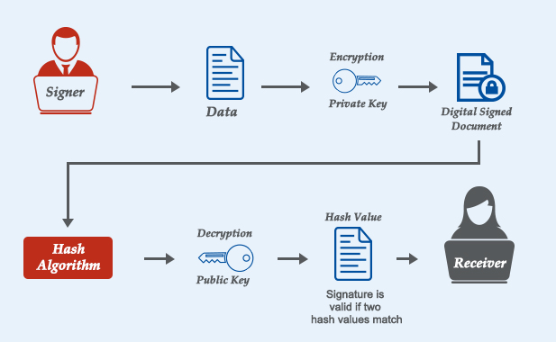
BCSE309L - Cryptography and Network Security
Module 5 - Digital Signature and Authentication Protocols

Slide 2
Contents
CO3 : To apprehend the authentication and integrity process of data for various applications
Authentication Requirements, Authentication Functions, Message Authentication Codes
Digital Signature Authentication, Authentication Protocols
Digital Signature Standards (DSS)
RSA Digital Signature, Elgamal based Digital Signature
Authentication Applications: Kerberos
X.509 Authentication Service
Public Key Infrastructure (PKI)

Slide 3
Message Authentication Requirements
In the context of communications across a network, the following attacks can be identified:
Disclosure: Release of message contents to any person or process not possessing the appropriate cryptographic key
Traffic analysis: Discovery of the pattern of traffic between parties
In a connection-oriented application, the frequency and duration of connections could be determined
In either a connection-oriented or connectionless environment, the number and length of messages between parties could be determined
Masquerade: Insertion of messages into the network from a fraudulent source
Example:
The creation of messages by an opponent that are purported to come from an authorized entity
The fraudulent acknowledgments of message receipt or nonreceipt by someone other than the message recipient

Slide 4
Message Authentication Requirements – cont…
4. Content modification: Changes to the contents of a message, including insertion, deletion, transposition, and modification
5. Sequence modification: Any modification to a sequence of messages between parties, including insertion, deletion, and reordering
6. Timing modification: Delay or replay of messages
In a connection-oriented application, an entire session or sequence of messages could be a replay of some previous valid session, or individual messages in the sequence could be delayed or replayed
In a connectionless application, an individual message (e.g., datagram) could be delayed or replayed
7. Source repudiation: Denial of transmission of message by source
8. Destination repudiation: Denial of receipt of message by destination

Slide 5
Requirements for MACs
Taking into account the types of attacks
Need the MAC to satisfy the following:
Knowing a message and MAC, is infeasible to find another message with same MAC
MACs should be uniformly distributed
MAC should depend equally on all bits of the message
Notes:
5
In assessing the security of a MAC function, we need to consider the types of attacks that may be mounted against it. Hence it needs to satisfy the listed requirements.
The first requirement deals with message replacement attacks, in which an opponent is able to construct a new message to match a given MAC, even though the opponent does not know and does not learn the key.
The second requirement deals with the need to thwart a brute-force attack based on chosen plaintext.
The final requirement dictates that the authentication algorithm should not be weaker with respect to certain parts or bits of the message than others.

Slide 6
Message Authentication
A procedure to verify that received messages come from the alleged source and have not been altered
Message authentication may also verify sequencing and timeliness
A digital signature is an authentication technique that also includes measures to counter repudiation by the source

Slide 7
Message Authentication Functions
Any message authentication or digital signature mechanism has two levels of functionality
At the lower level, there must be some sort of function that produces an authenticator: a value to be used to authenticate a message
This lower-level function is then used as a primitive in a higher-level authentication protocol that enables a receiver to verify the authenticity of a message

Slide 8
Authenticator Generating Functions
Hash function: A function that maps a message of any length into a fixed-length hash value, which serves as the authenticator
Message encryption: The ciphertext of the entire message serves as its authenticator
Message Authentication Code (MAC): A function of the message and a secret key that produces a fixed-length value that serves as the authenticator

Slide 9
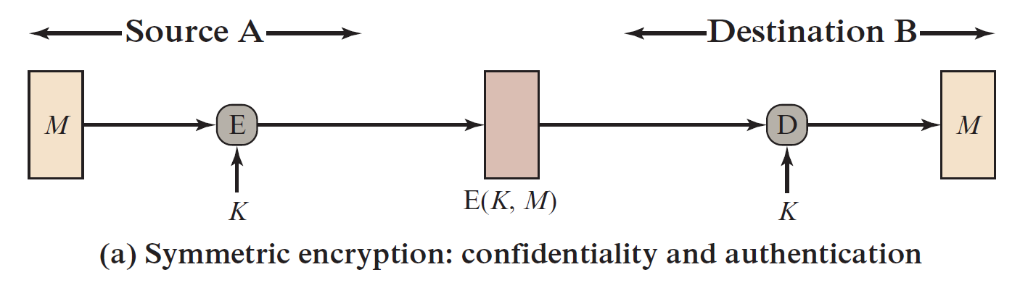
2. Message Encryption Symmetric Encryption

Slide 10
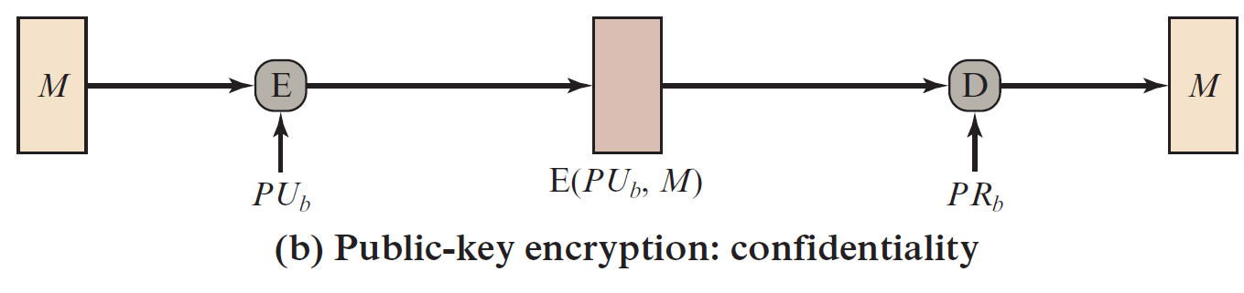
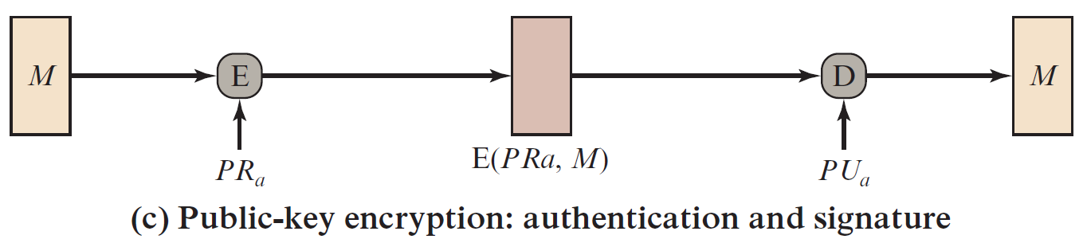
2. Message Encryption Public-key Encryption

Slide 11
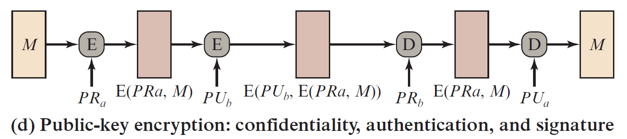
2. Message Encryption Public-key Encryption – cont…

Slide 12
3. Message Authentication Code
Use of a secret key to generate a small fixed-size block of data, MAC, that is appended to the message
Assumes two communicating parties, say A and B, share a common secret key K. When A has a message to send to B, it calculates the MAC as a function of the message and the key:
MAC = C(K, M)
where
M = input message
C = MAC function
K = shared secret key
MAC = message authentication code

Slide 13
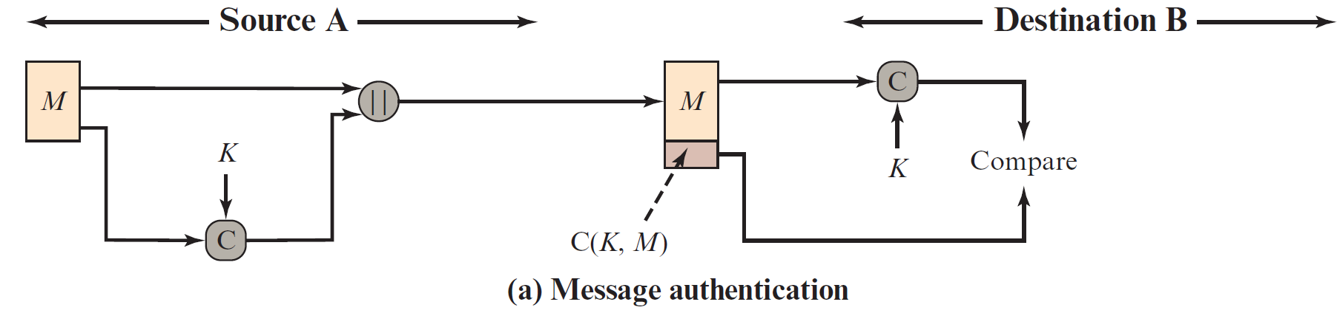
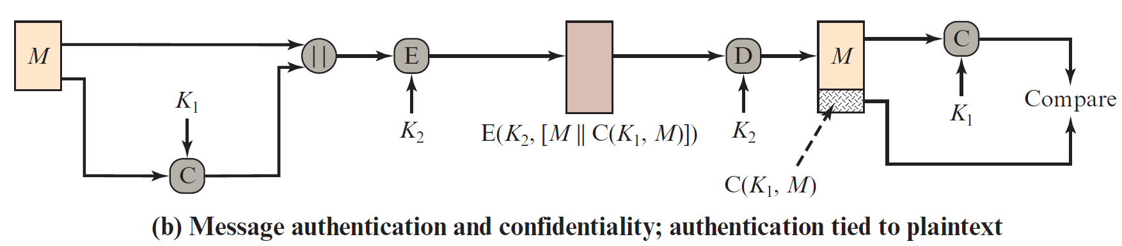
Basic Uses of Message Authentication code (MAC)
Confidentiality:
Encryption using 𝐾2 ensures that only authorized recipients can read the message.
Hash function: Authenticity and Integrity

Slide 14
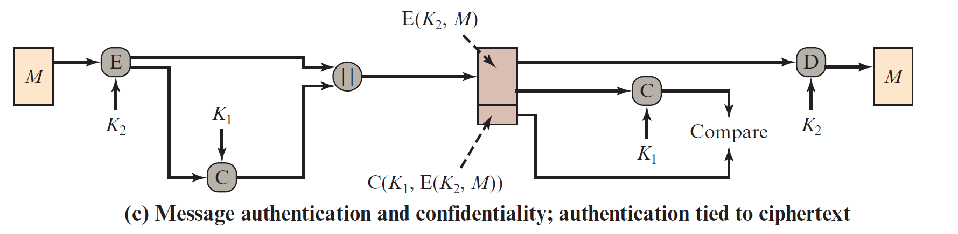
Basic Uses of Message Authentication code (MAC) – cont…

Slide 15
Digital Signatures

Slide 16
Digital Signatures
Authentication mechanism that enables the creator of a message to attach a code that acts as a signature
Digital Signature Standard (DSS)
NIST standard for Secure Hash Algorithm (SHA)
Most important development of public-key cryptography
Private Key
H(M)
Encryption Algorithm
Digital Signature

Slide 17
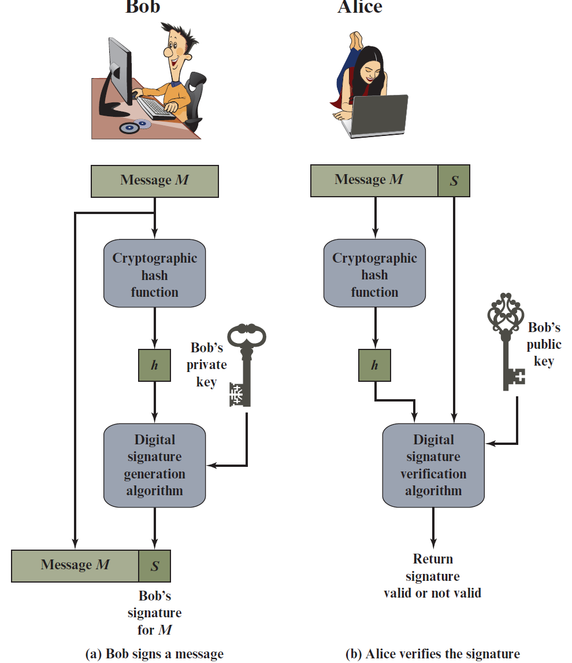
Essential Elements of Digital Signature Process

Slide 18
Example
Suppose that John sends an authenticated message to Mary
Consider the following disputes that could arise:
Mary may forge a different message and claim that it came from John. Mary would simply have to create a message and append an authentication code using the key that John and Mary share
John can deny sending the message. Because it is possible for Mary to forge a message, there is no way to prove that John did in fact send the message

Slide 19
Properties of Digital Signature
The digital signature must have the following properties:
It must verify the author and the date and time of the signature
It must authenticate the contents at the time of the signature
It must be verifiable by third parties, to resolve disputes

Slide 20
Digital Signature Requirements
The signature must be a bit pattern that depends on the message being signed
The signature must use some information only known to the sender to prevent both forgery and denial
It must be relatively easy to produce the digital signature
It must be relatively easy to recognize and verify the digital signature
It must be computationally infeasible to forge a digital signature, either by constructing a new message for an existing digital signature or by constructing a fraudulent digital signature for a given message
It must be practical to retain a copy of the digital signature in storage
A secure hash function, embedded in a scheme, provides a basis for satisfying these requirements

Slide 21
Direct Digital Signature
A direct digital signature is a cryptographic method where a sender signs a message using their private key, ensuring message integrity, authenticity, and non-repudiation
Process of Direct Digital Signature
Message Hashing:
The sender computes a hash of the message using a cryptographic hash function (e.g., SHA-256)
This ensures a fixed-length digest that represents the message uniquely
Signing the Hash:
The sender encrypts the hash using their private key, creating a digital signature
This ensures that only the sender, who owns the private key, could have signed the message

Slide 22
Cont…
Sending the Message:
The sender sends the original message and the digital signature to the recipient
Verification by Receiver:
The recipient decrypts the digital signature using the sender’s public key, revealing the original hash
The recipient independently hashes the received message and compares it to the decrypted hash
If both match, the signature is valid, proving the message's authenticity and integrity

Slide 23
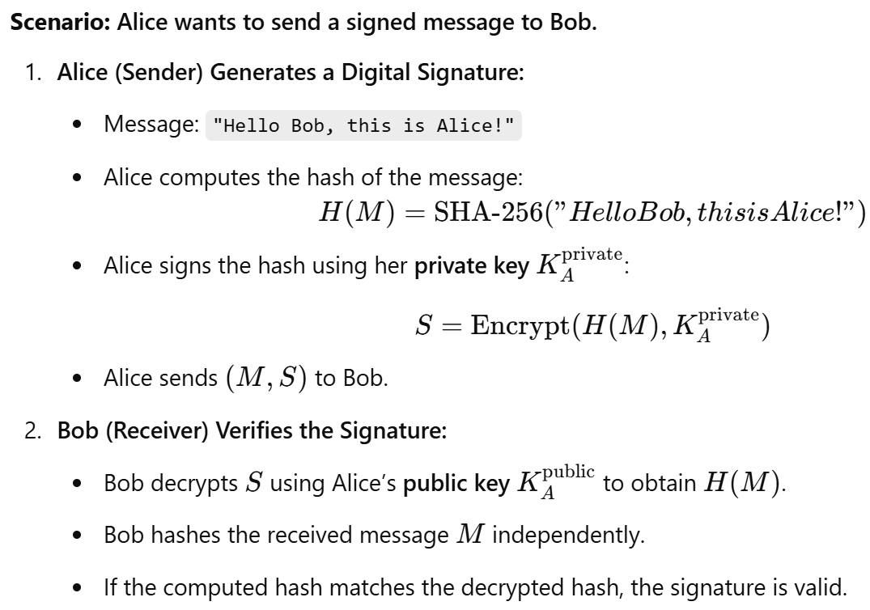
Example of Direct Digital Signature

